Slide 2
MXCuBE | LIMS site report
NMX, European Spallation Source
Aaron Finke & Laís Pessine do Carmo

Slide 3
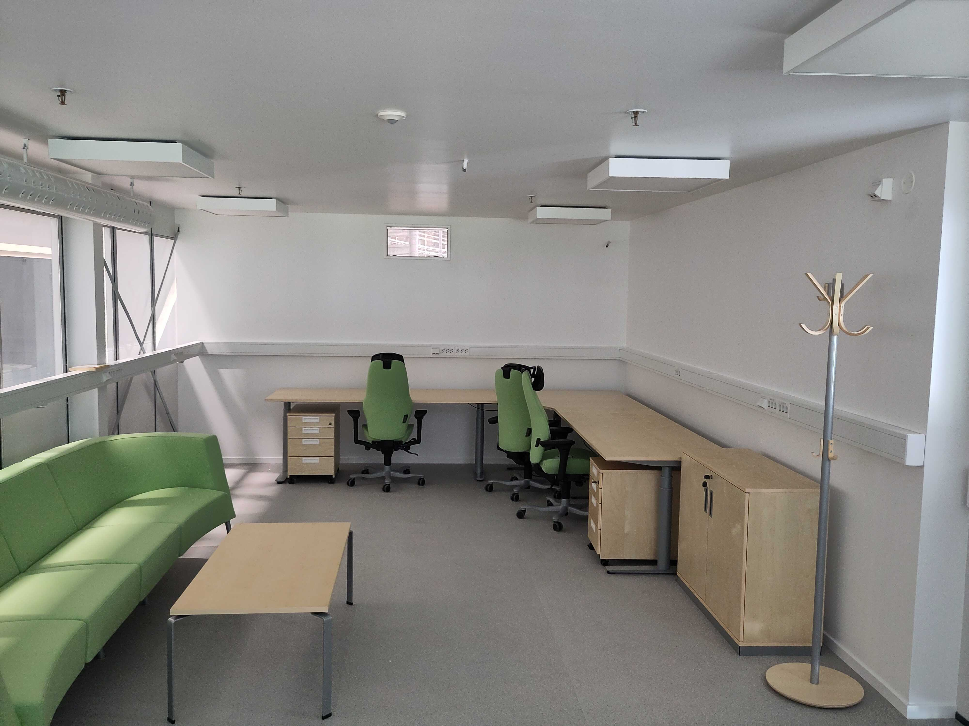
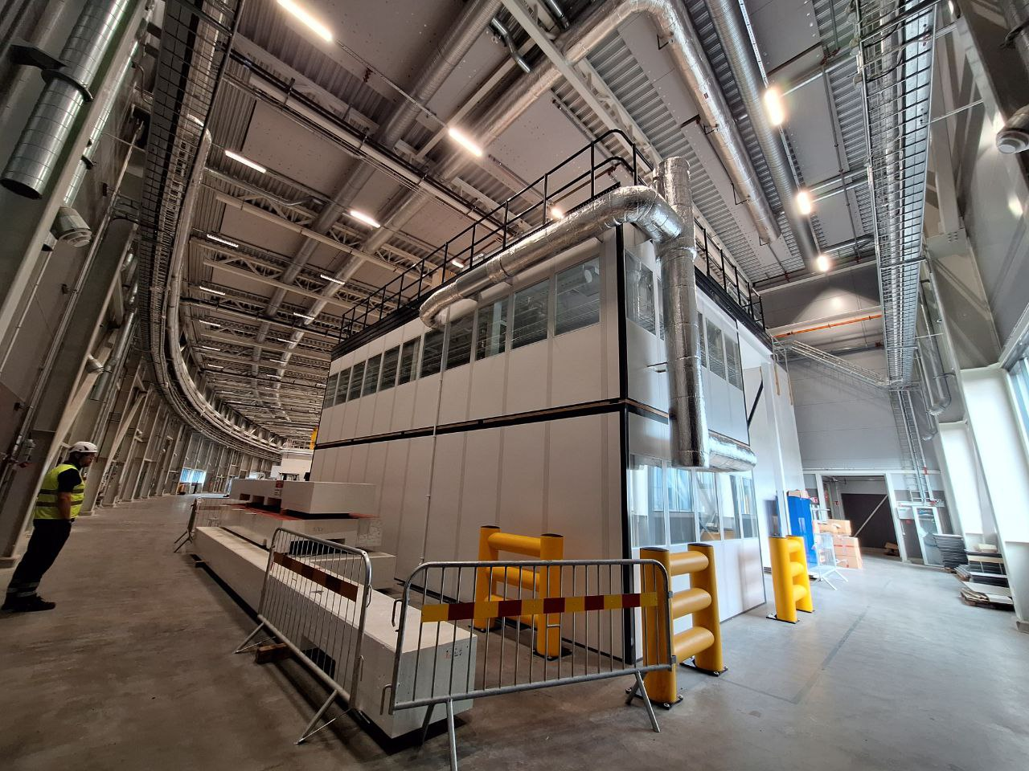
ESS/NMX Status
NMX is a planned Laue-TOF instrument for neutron protein crystallography at ESS
ESS Beam on target (to produce neutrons) milestone is May 2025
Cold commissioning (no neutrons) starts January
Hot commissioning (w/ neutrons) scheduled Oct 2025
First science Early 2026
NMX control hutch (inside / outside)

Slide 4

MXCuBE | LIMS status
NMX to use ESS SSO service for access/login (already integrated into ESS SciCat), controlled via User Office website
Security: No remote connection to NMX planned (for now)
SciCat to be used for data cataloging
Not using ISPyB due to smaller expected user base of NMX
Running ISPyB is a full time job; we don’t have the resources for it
Max Novelli works down the hall from me (buy him a beer, I ask a lot out of him)
SciCat Web UI is pretty barebones at the moment but is highly extensible and customizable
ESS User Office
MXCuBE

Slide 5
MXCuBE | LIMS status
DB integration with e.g. MAX IV an uphill battle due to Swedish/EU red tape
but it would be nice for e.g. BioMAX users to be able to access NMX data directly in EXI…
(in my dreams)
(and Alberto’s nightmares)
Github: repos for ESS MXCuBE
https://github.com/ess-dmsc/mxcubeweb
https://github.com/ess-dmsc/mxcubecore
ESS User Office
MXCuBE

Slide 6
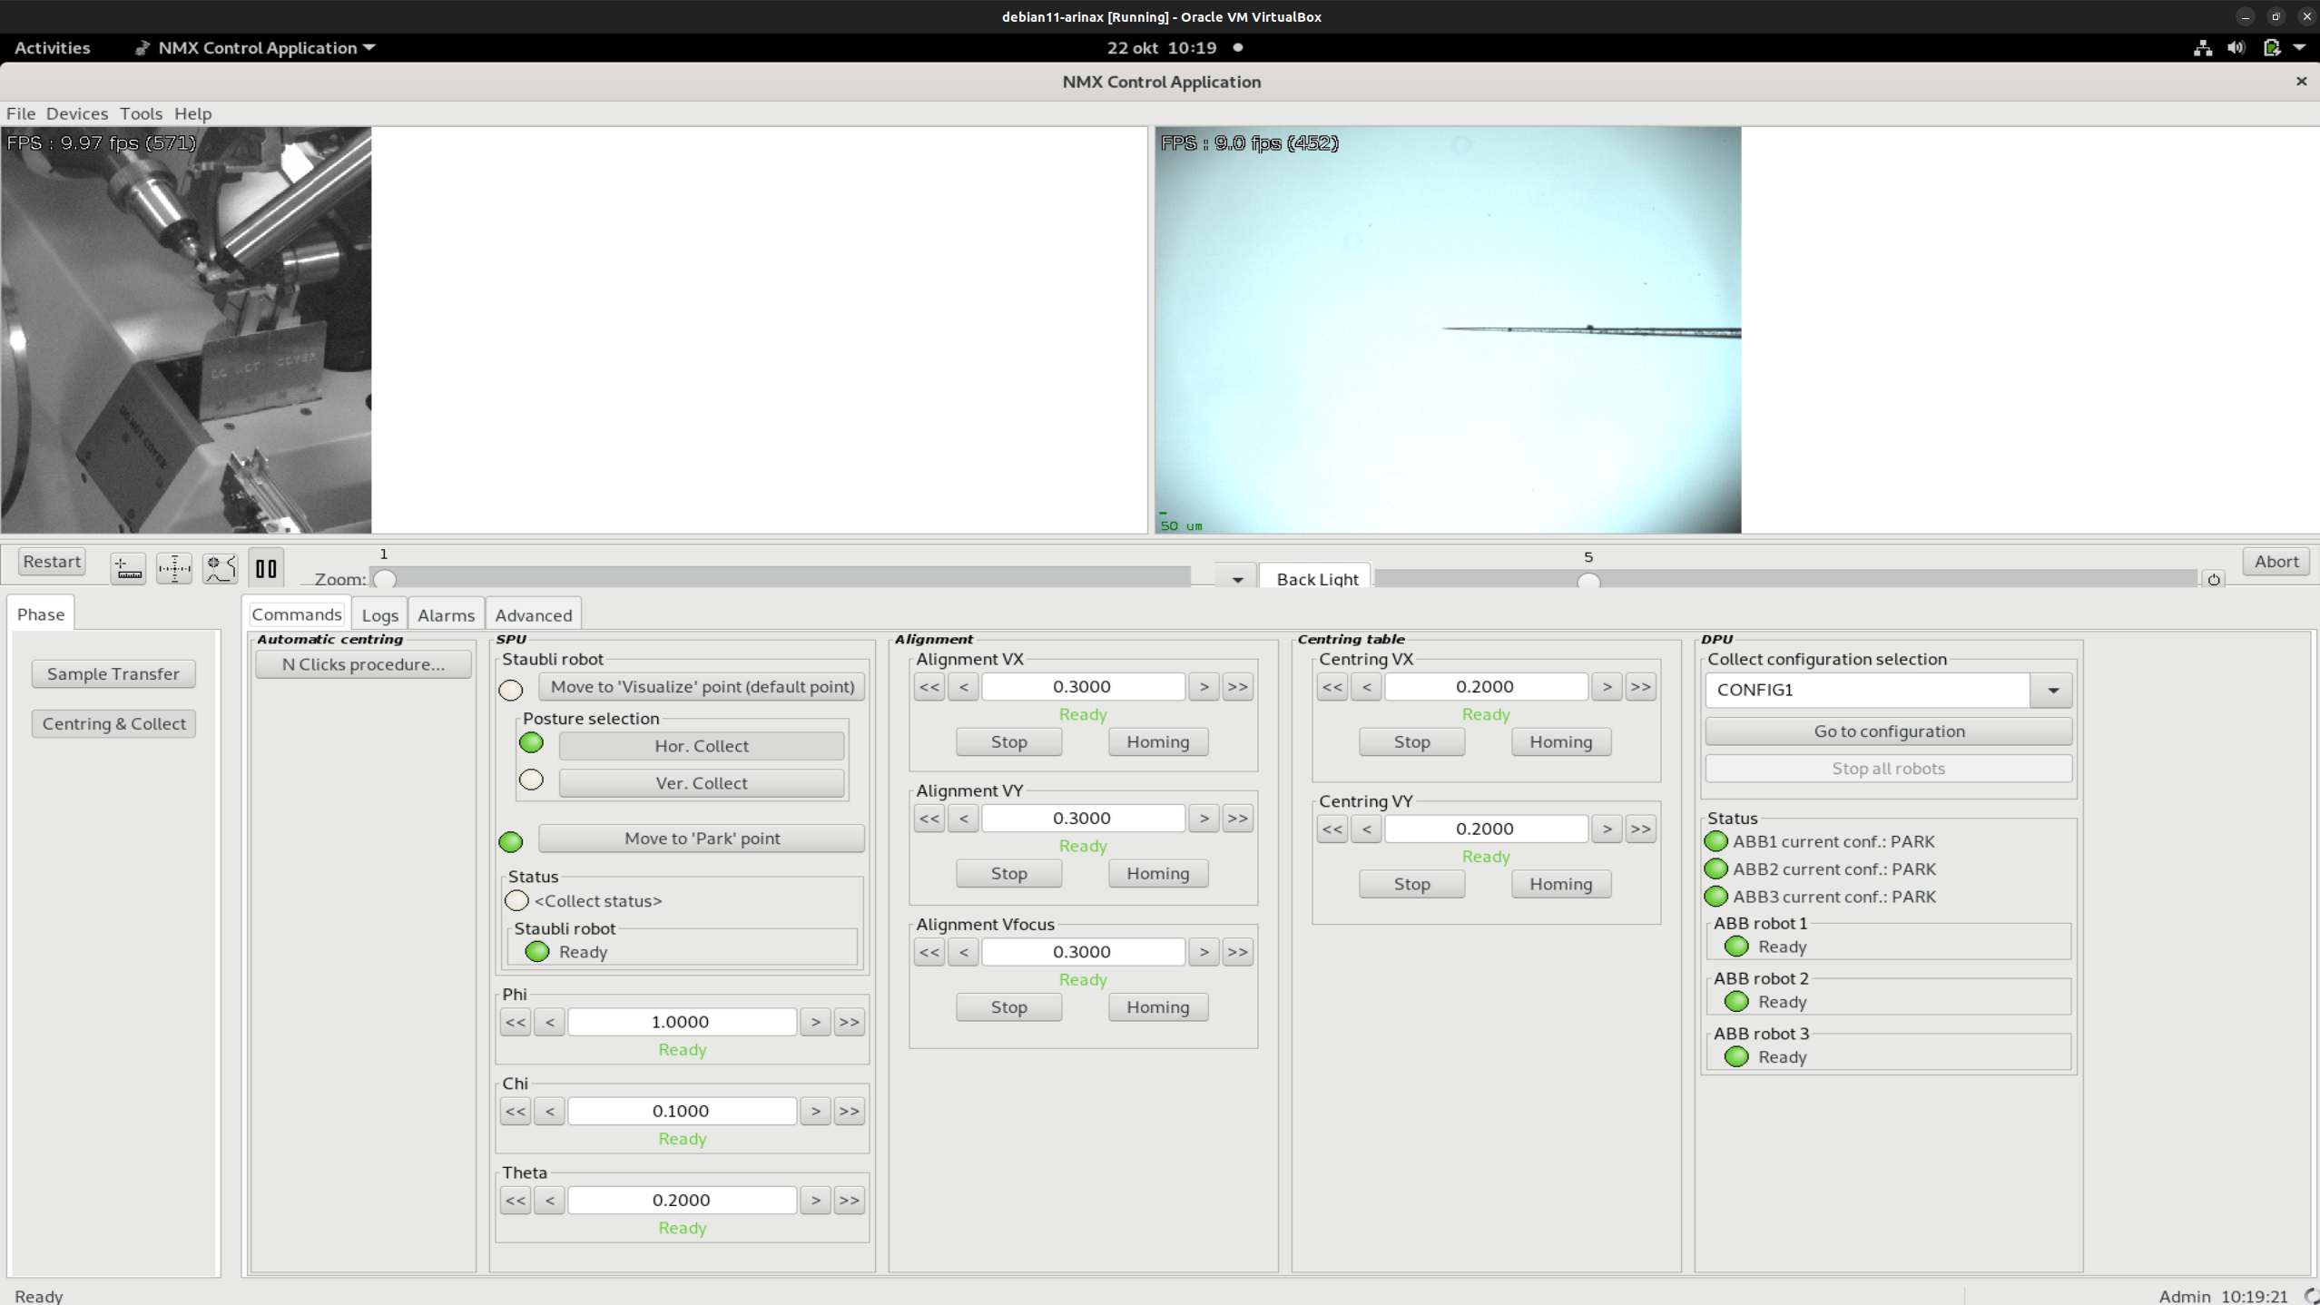
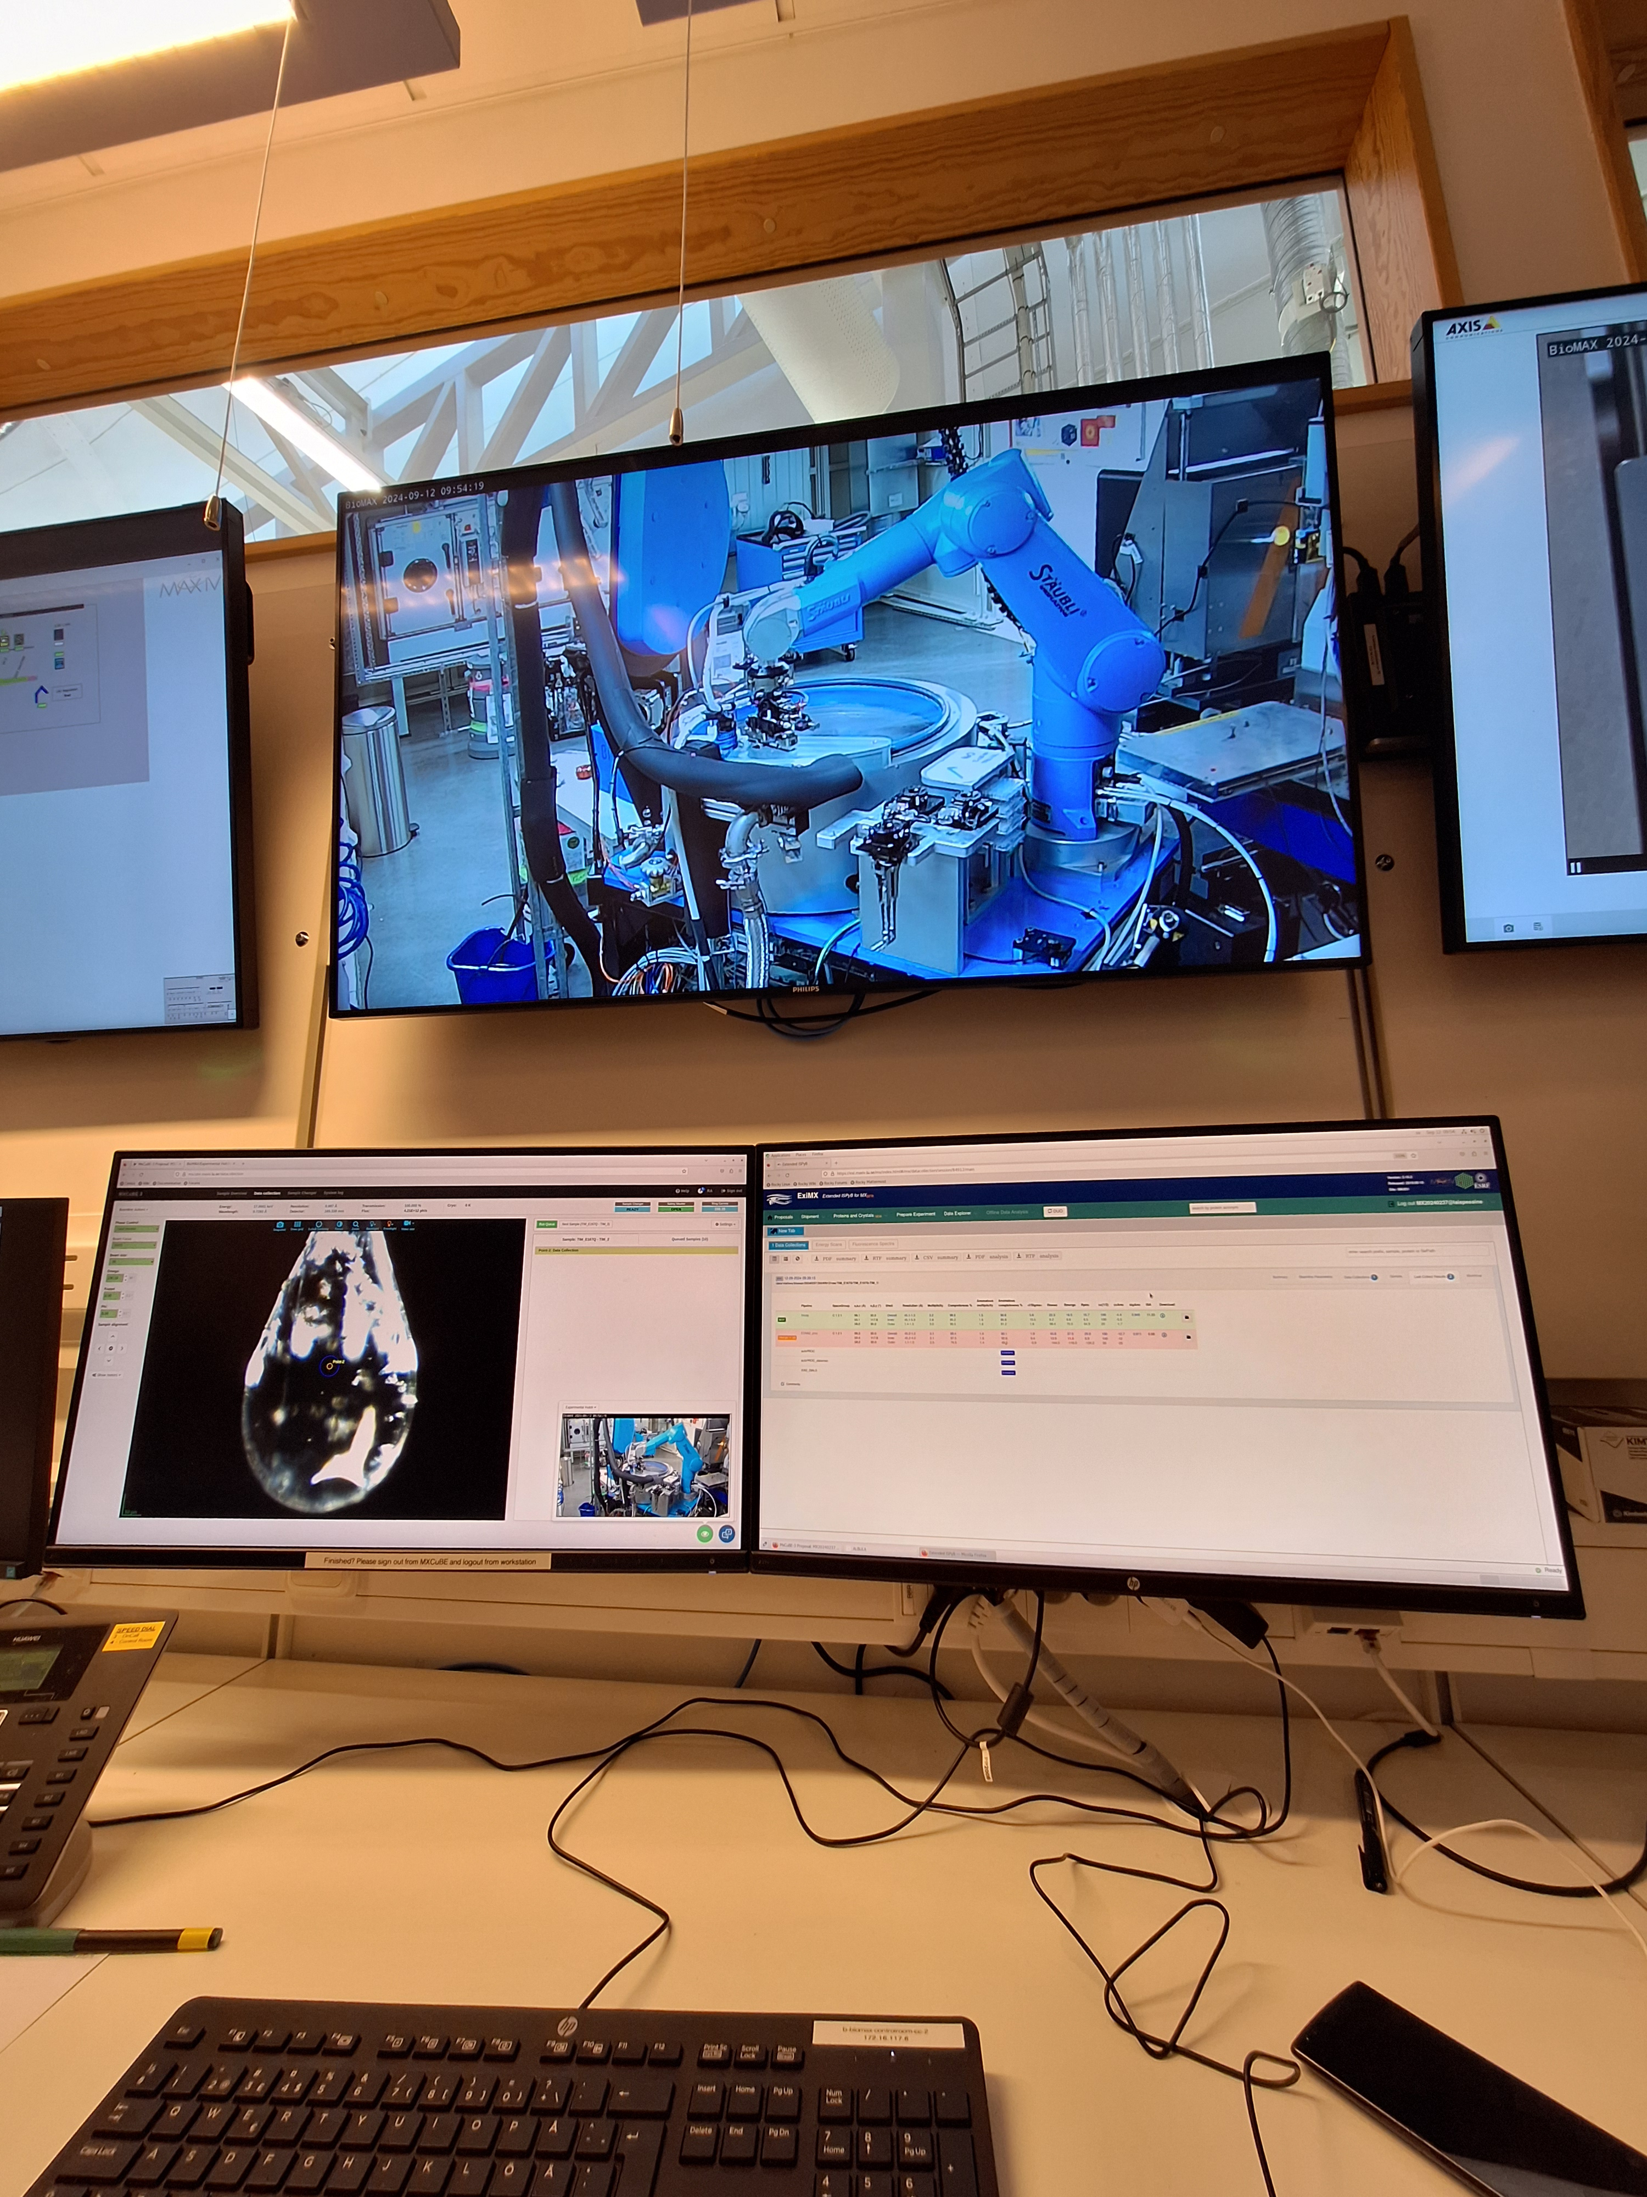
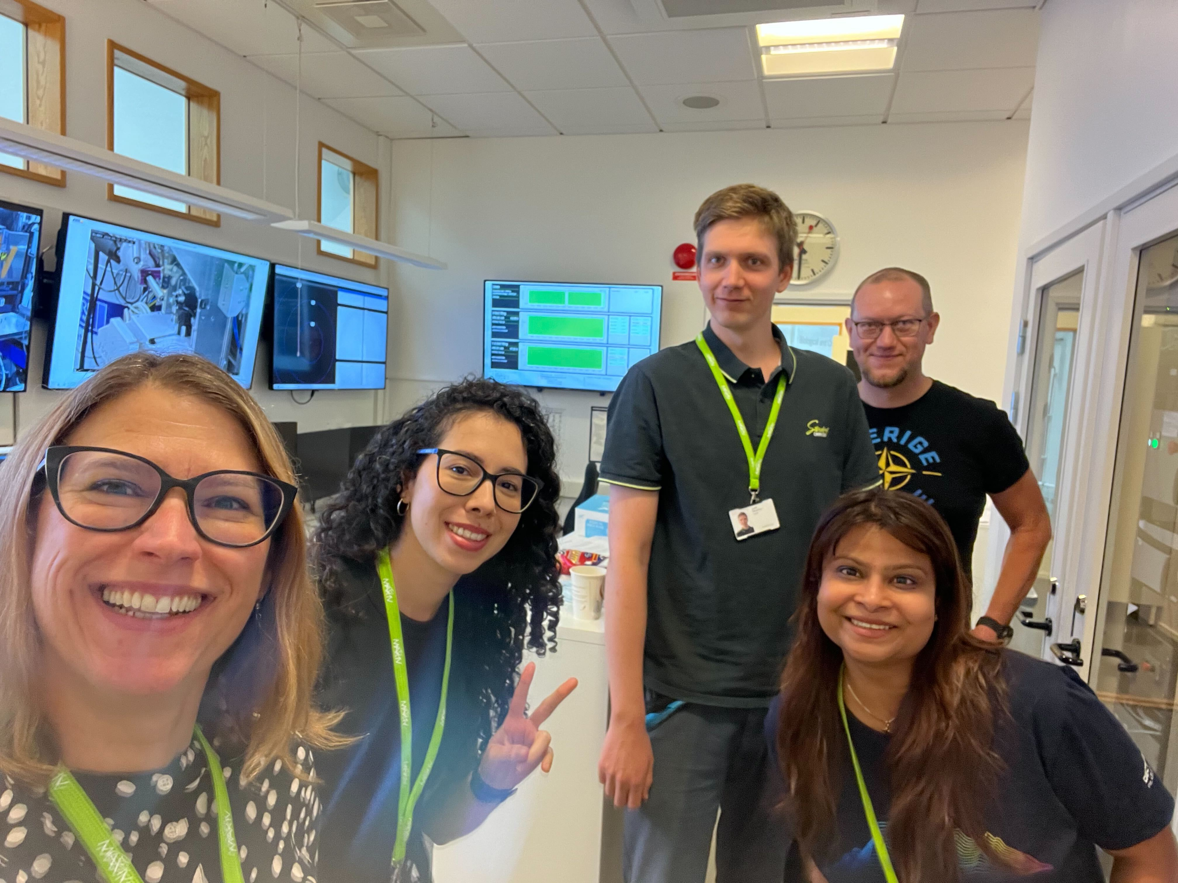
Updates
Software
Infrastructure
ARINAX software mockup for controlling robots
mxcubeweb and NICOS (high-level control software á la Tango, for controlling EPICS devices), deployed in the ESS internal network (one VM for each).
UI Design
Most of MXCuBE@NMX will be retained, but some things need to change, e.g.
No sample changer
Wavelength range (Laue)
Laue data collection is series of stills, no rotation
Strategy calculation (data collection times will be in > hours)
Data collection at BioMAX (thanks MX Group!)
ARINAX mockup software (UI), for the robots and sample camera control
Data collection at BioMAX (MAX IV)

Slide 7
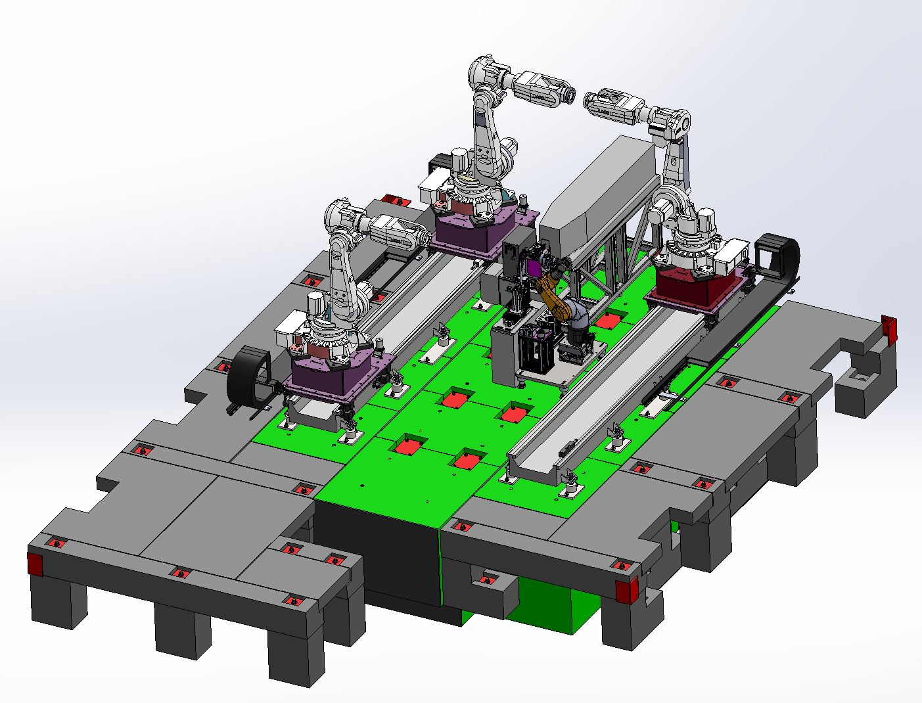
Updates
Hardware
Lots of upstream components installed
ARINAX video and motion mockup software received. Installed and testing
First Python scripts to access ARINAX data remotely
In progress:
Integrating MXCuBE and NICOS
Video and motion control from ARINAX
View of NMX experimental hutch
Robots/gonio from ARINAX

Slide 8
Plans for the next six months
Software
Integrate ARINAX equipment to ESS, control software
Finalize MXCuBE UI Changes for NMX Data collection
Work on SciCat/User Office communication
Strategy calculation software (highest completeness/redundancy in the shortest amount of time)
Updating Laue wavelength scaling routine
Work with DIALS team (David McDonaugh) on data reduction pipeline
User Office
MXCuBE

Slide 9
Plans for the next six months
Hardware
NMX Hutch installation/power-up ⚡️
Delivery of ARINAX equipment
Detector Testing:
NMX detector are area detectors based on gas electrode multiplier (GEM) technology used in ATLAS at LHC
Detectors built at CERN (in-kind contribution)
Will be tested at neutron MX instruments incl LADI (ILL), NOBURU (J-PARC)

Slide 10
Thanks!
NMX team @BioMAX (not pictured: me)

